Slide 1
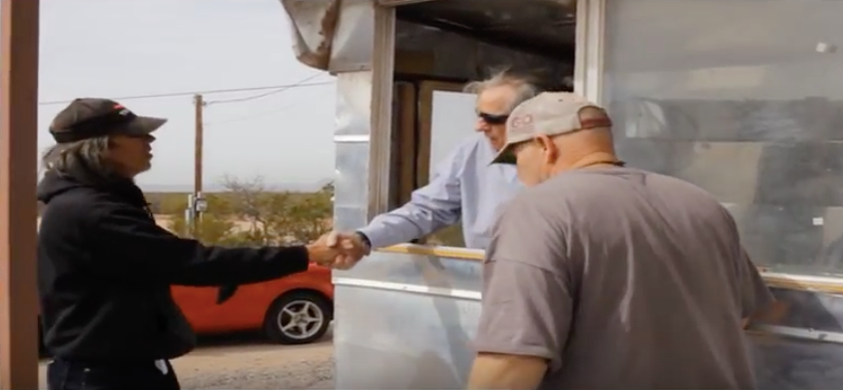
‘Spice Head Falls Out’ YouTube
A documentary done as Public Service to Residents of City of Las Cruces by
VETERANS THEATER

Slide 2
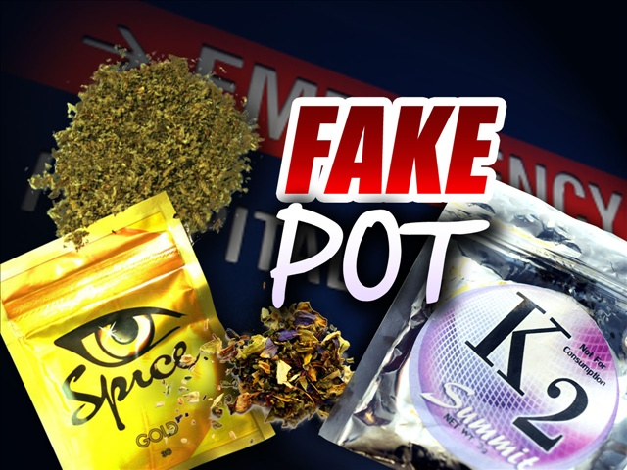
Our Purpose
To educate Our City's Leaders and the public about this new fast evolving threat of Synthetic Marijuana in Las Cruces.

Slide 3
Executive Summary: Our Aim Today
We seek a vote of confidence for our vision: Ending Spice Trade in Las Cruces

Slide 4
Who is Veterans Theater?
NTENARRATIVE Foundation' BOARD OF TRUSTEES
David M. Boje, (Veteran Army) President & NMSU Regents Professor 575-936-9578 (cell) or David@davidboje.com
James Sassak, VP
Nancy Starr Breard, EDD, Treasurer 864-706-4282
Ernest Ramey, Secretary (Veteran Army)
John Hawk, Agent-at-large (Veteran Navy)
Wanda Whittlesey-Jerome MSW Social Work NMSU Professor

Slide 5
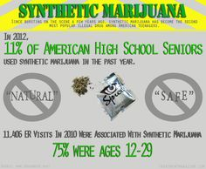
Our Approach
VETERANS THEATER is taking Theater to the Streets
TO DO SOMETHING TO STOP THE SPICE TRADE.
1 IN 9 TEENS TRY SPICE. 2000 VETERANS GOT DISCHARGED FOR USING SPICE. SPICE IS EPIDEMIC IN AMERICA

Slide 6
Spice Video for Las Cruces Residents
James Sassak who wrote and directed this documentary video https://www.youtube.com/watch?v=RNU_t01BeGs&feature=youtu.be
and the actors of Veterans Theater (Ernest Ramey, James Sassak, & David M. Boje) have watched with ever growing concern as Synthetic Marijuana use has become rampant in Las Cruces and across our Nation.

Slide 7
The Video Scenes
In Scene one we show the deceptive nature of the way Synthetic Marijuana is marketed in smoke shops with a disclaimer that it is not for human consumption, while the vendors know full well the end use for the product.
In scene two we see the trafficking strategies that maximize profits and push the Drug at he street level.
Finally in scene three we see the tragic and deadly Consequences of smoking Spice.

Slide 8
Spice is a growing problem
Both Memorial and Mountain View Medical Centers have reported to have an increase of patients due to Spice use or overdoses.
http://www.lcsun-news.com/story/news/crime/2015/10/03/spice-whirl-rise-last-resort-drug/73300844/

Slide 9
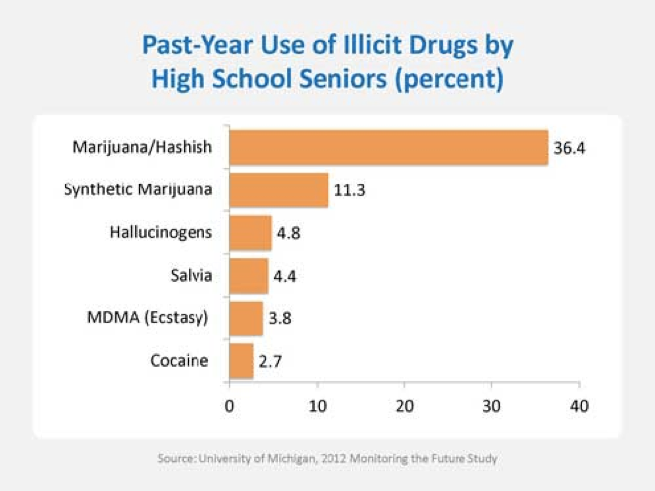

Slide 10
Just the Facts
FACT: The average age of synthetic marijuana users is 13
FACT: 1 in 9 High School students try Spice (K2, Fake Weed)
FACT: Parolees use synthetic marijuana to fool the tests for drug use
FACT: In 2015: "It seemed as if an upswing in such incidents here, which began in June, had suddenly and dramatically spiked" - Times Leader
FACT: PCP often is applied to a leafy material such as mint, parsley, oregano, or marijuana, so users can smoke it, according to NIDA’s website, www.drugabuse.gov.
FACT: Synthetic Weed Is Ravaging New Mexico's Homeless Population. "You don't have to feel emotions or pain and all those kinds of things. The majority of these shelters don't have programs for these guys, they don't have activities, so this is what they do all day." --vice.com
FACT: In 48 hour period, in Sept 2015, in Las Cruces, there were 17 overdoses, and two died, but the hospitals lack the testing equipment to tell if its Fake Pot.

Slide 11
Statistics on Spice
“Spice” or “K2”—has become the second most popular illegal drug among American teenagers, after MJ.
Sometimes touted as a “natural,” “safe,” and (until recently) legal alternative to pot, this very un-natural class of designer chemicals has shown itself to be a dangerous threat.
Thousands of teens and young adults, mostly young males, are ending up in emergency rooms with severe symptoms that may include vomiting, racing heartbeat, elevated blood pressure, seizures, or hallucinations.”
-www.drugabuse.gov

Slide 12
The Problem
Spice: Uncontrolled substance killing residents, dividing communities
LAS CRUCES – TO MANY IN LAW ENFORCEMENT, IT SEEMS IMPOSSIBLE — LIKE ROLLING A BOULDER UP A MOUNTAIN. Damien Willis, Las Cruces Sun-News Sunday Feb 1st 2016
See Sun-News Editorial Feb 4 on what can be done to create a local ordinance
Spice whirl: The rise of a last-resort drug ..
By Damien Willis, Las Cruces Sun-News9:20 p.m. MDT October 3, 2015
New Las Cruces theater group gives voice to veterans, homeless
By Mike Cook Las Cruces Bulletin, 5 February, 2016

Slide 13
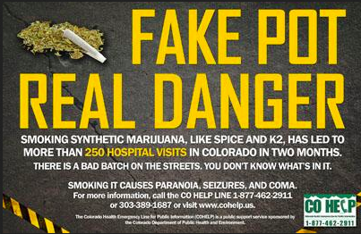
The Magnitude of the Problem
Spice can be so deadly that $2 can buy enough of the Drug to kill anyone that uses it

Slide 14
EMT Report
American Medical Response of Doña Ana County, stated that it had responded to 219 overdoses, though not specifically Spice overdoses, between Jan. 8 and Aug. 15 of 2015 — an average of one overdose per day. Between Aug. 16 and September 30, paramedics responded to 58 overdoses, an average of 1.26 per day.

Slide 15
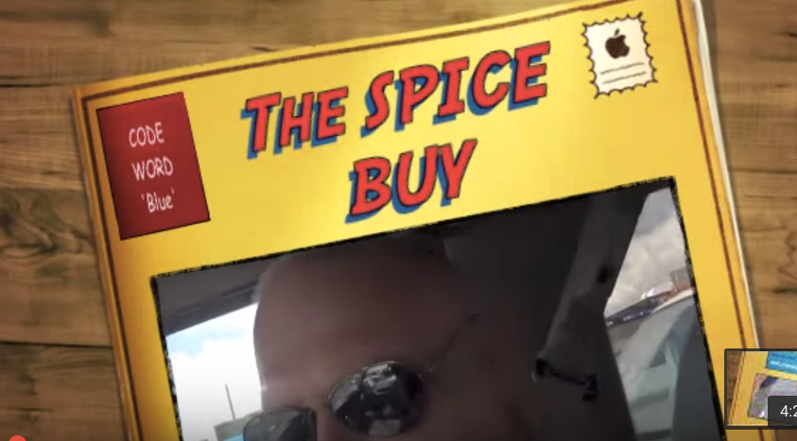
Need for Codes for Spice Sale and Distribution
Final_spice_buy_film_sept_11_2015 YouTube
by Veterans Theater
We did a buy of SPICE (k2) 2 days after the police raided the place, and …

Slide 16
Solutions
Only through education and awareness and strong leadership at the State and local level do we stand a chance to ban and eradicate Spice problem

Slide 17
Recommendations
We recommend strong city ordinances to penalize the sale and distribution of Spice, including revocation of business license
1. Pull Business License of those who produce, distribute, and sell
2. City Council pass an ordinance making it $500 fine and a misdemeanor charge to manufacture, distribution, and possession

Slide 18
Example of Enforcement Option
“Anchorage [Alaska] already had a measure to combat Spice, passed in 2014 to stop over-the-counter sales. This new one updates the legal mechanisms for charging and prosecuting it, charging a $500 ticket for misbranding synthetic drugs, and attaching a misdemeanor charge to manufacture, distribution, and possession.” Las Cruces could adopt similar measures. http://www.alaskapublic.org/2015/11/11/anchorage-spice-ordinance-aims-at-dealers-and-distributors/

Slide 19
New York Example
"NYC Selling or producing K2 was previously only considered a health code violation in New York state, punishable with a $250 fine. Under the new laws, offenders can be sentenced to a year in jail and fined up to $50,000. Shops could also be shut down" -- More.

Slide 20
MORE INFO
Some 450 synthetic (fake) cannabinoid compounds are sold by business, many here in the USA. Smoking spice leads to very aggressive, angry behavior, to vomiting stomach pain, severe anxiety, and too often death. Smoking spice is like playing Russian roulette.
READ MORE ON SPICE DANGERS TO LAS CRUCES at http://veteranstheater.com

Slide 21
What Parents Can do
https://spiceisnotnice.org/spice-edukit/ for more information

Slide 22
References
Veterans Theater ‘Spicehead Falls Out’ public service YouTube
Veterans Theater ‘Legacy Ranch’ an Eco-Village for Veterans YouTube
Veterans Theater ‘Spice Buy’ in Las Cruces YouTube
Additional Resources:
http://spiceaddictionsupport.org/side-effects-of-spice-use/
http://www.narconon.org/blog/synthetic-drug-abuse/what-makes-synthetic-marijuana-dangerous/
http://spiceaddictionsupport.org/what-is-spice/
http://spiceaddictionsupport.org/list-of-known-synthetic-cannabinoids/
https://en.wikipedia.org/wiki/Synthetic_cannabis
https://en.wikipedia.org/wiki/Cannabis
http://www.businessinsider.com/a-deadly-drug-called-k2-has-taken-over-an-entire-block-in-new-york-city-2015-9
http://www.drugpolicy.org/blog/how-did-marijuana-become-illegal-first-place

Slide 23
Our thanks to the Videographer
Jessie Sanchez, Student at New Mexico State University, team member doing Spice research in Mgt 375v Sustainability Development (Professor Boje, instructor).

Slide 24
Thank you from James Sassak, Ernest Ramey, and David M. Boje, Ph.D.

